Slide 1




Week-4 (Discussion)
18th Feb, 2025
Deep Learning
Prof. Sudarshan Iyenger
Professor and Head of the Department
Department of Computer Science and Engineering
IIT Ropar
Ayan Paul
PMRF Research Scholar
IIT Kharagpur

Slide 2
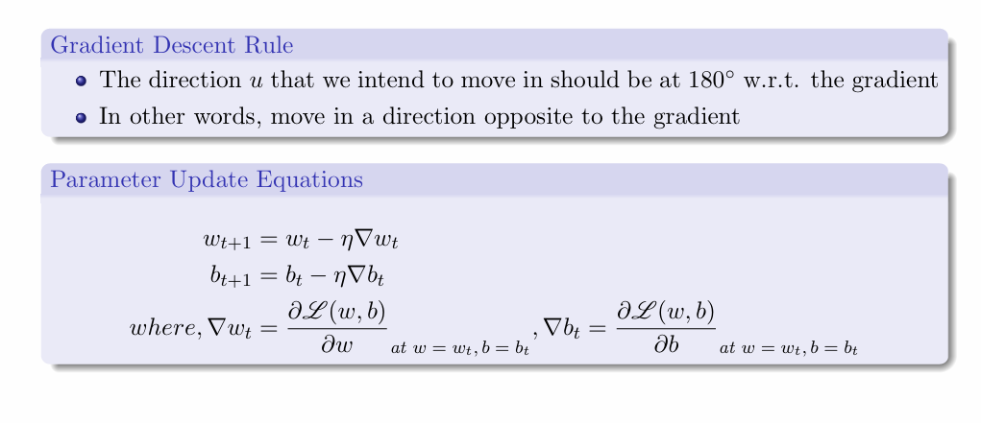
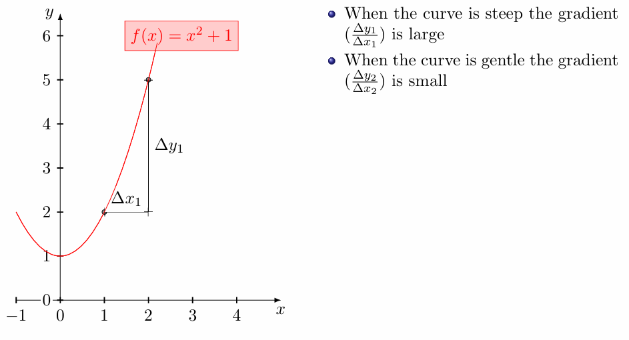
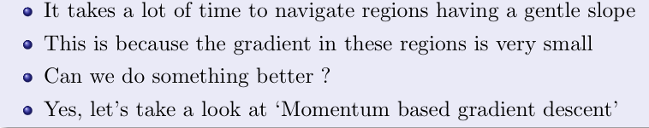
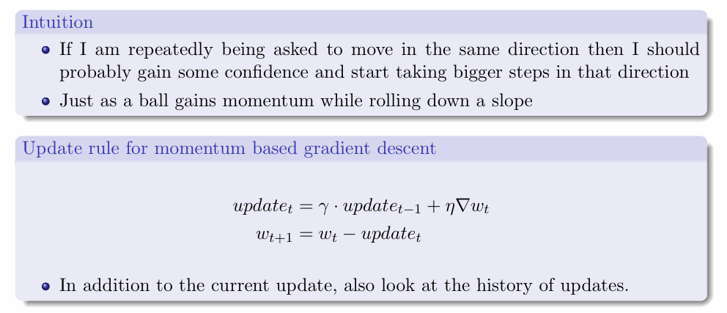
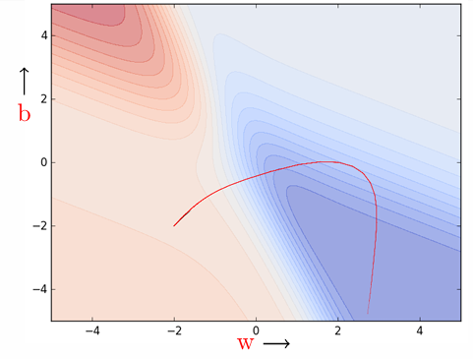
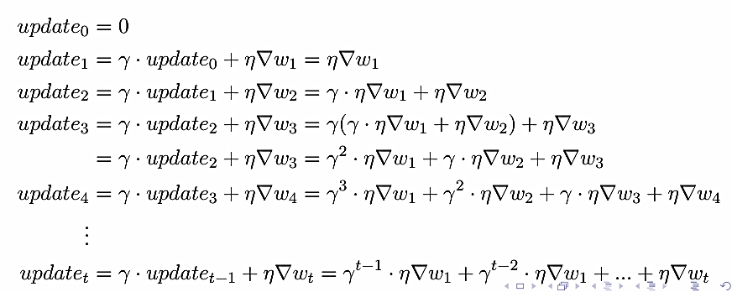
Gradient Descent
Limitations of Gradient Descent
Momentum based Gradient Descent

Slide 3
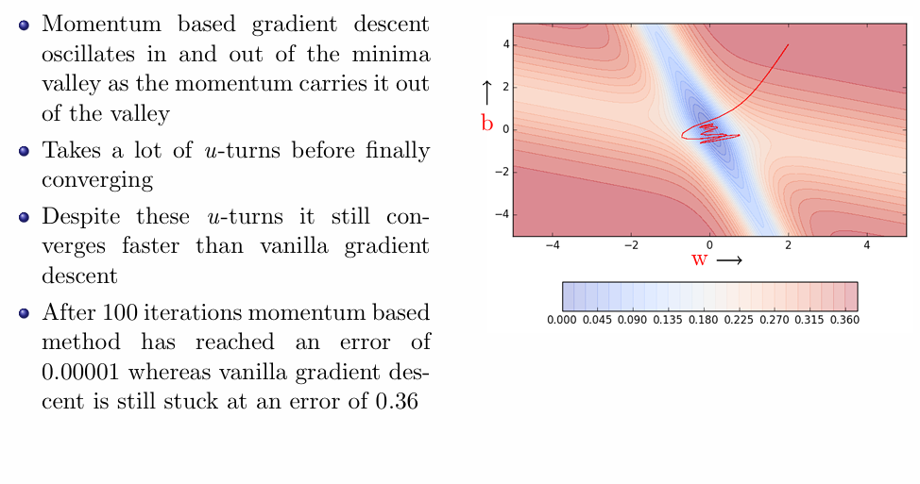
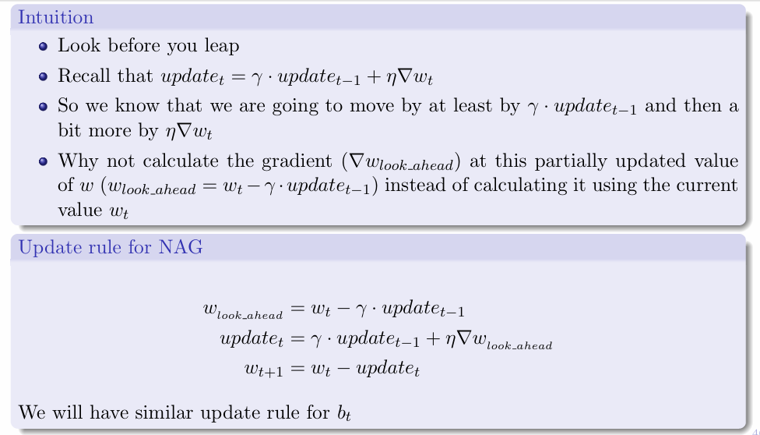
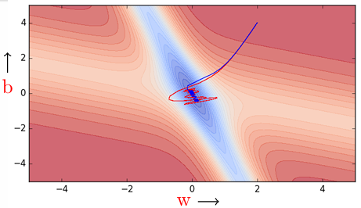
Limitations of Momentum Gradient Descent
Nesterov Accelerated Gradient Descent

Slide 4
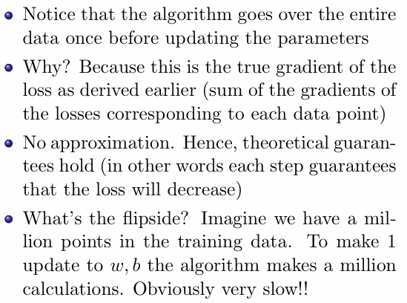
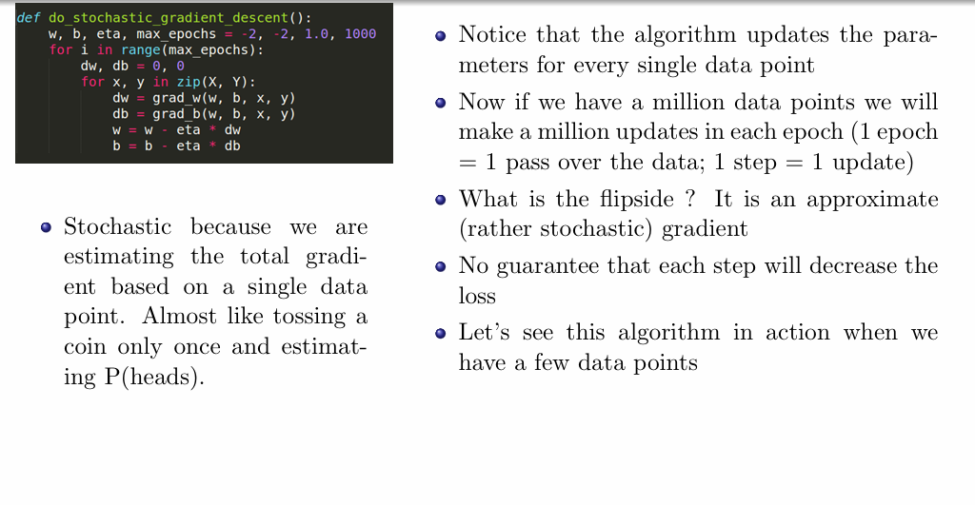
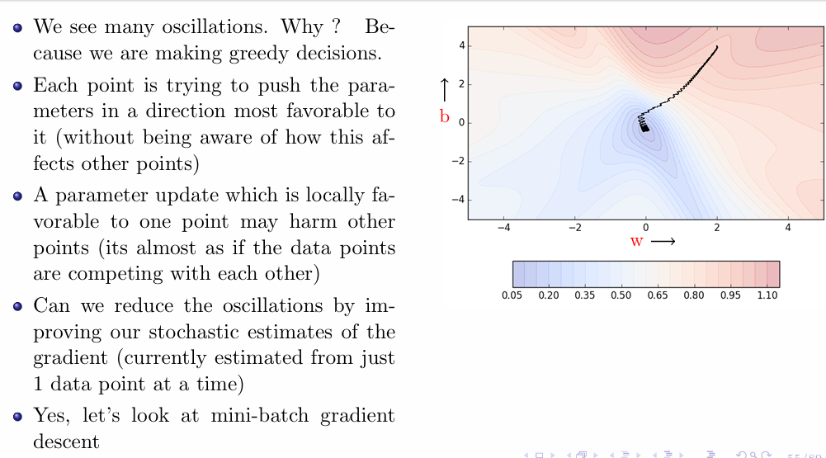
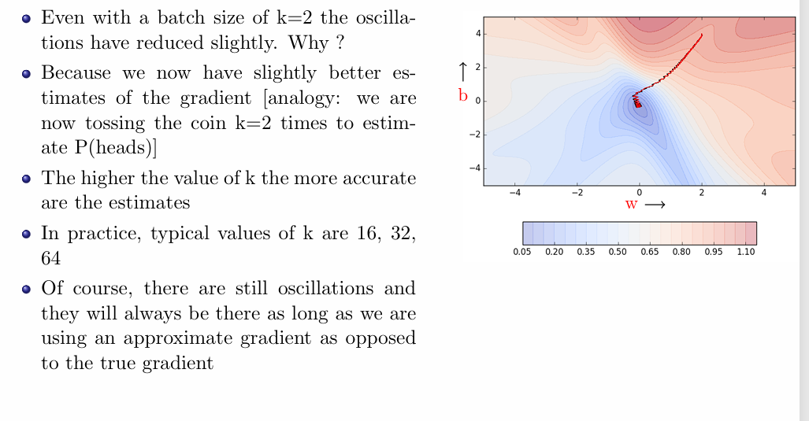
Limitations of Vanilla Gradient Descent
Stochastic Gradient Descent
Limitations of Stochastic Gradient Descent
Mini-Batch Gradient Descent

Slide 5
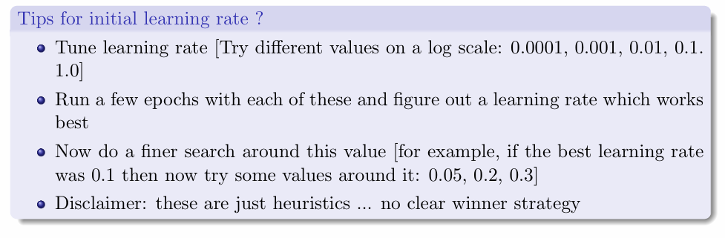
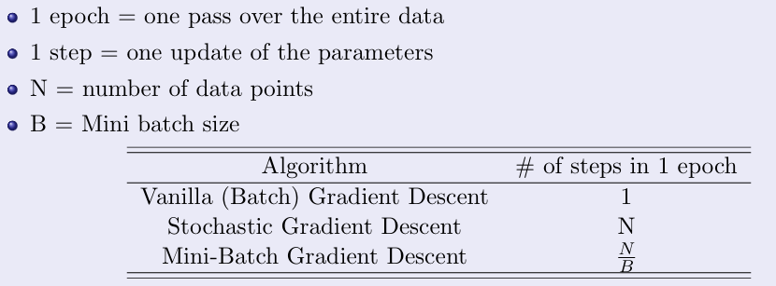
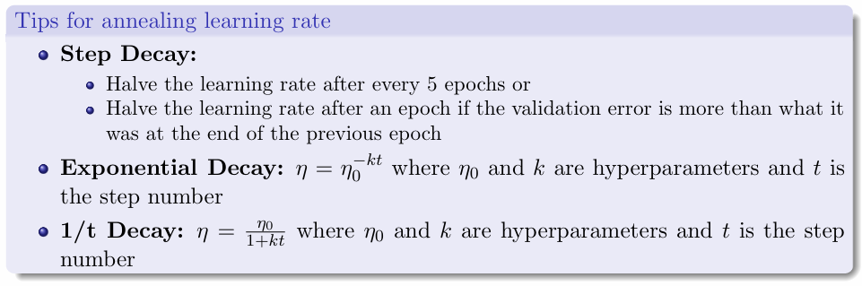
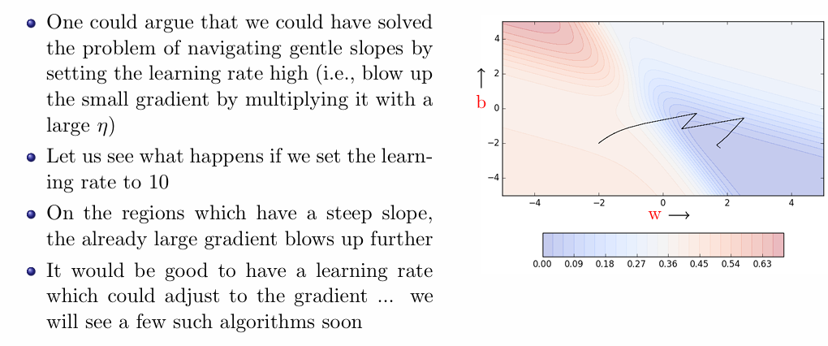
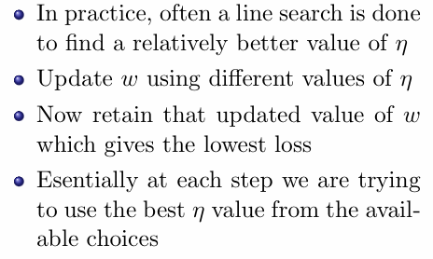
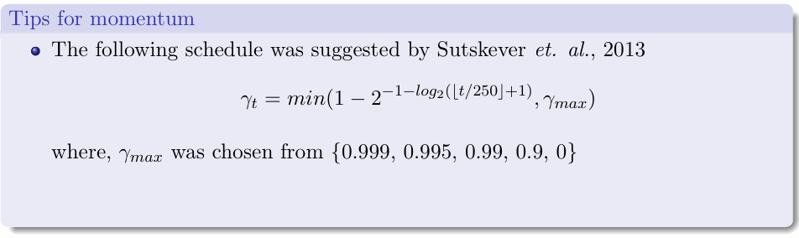
Update Rule
Learning Rate Selection
Limitations of Higher Learning Rate
Line Search
Momentum Selection

Slide 6
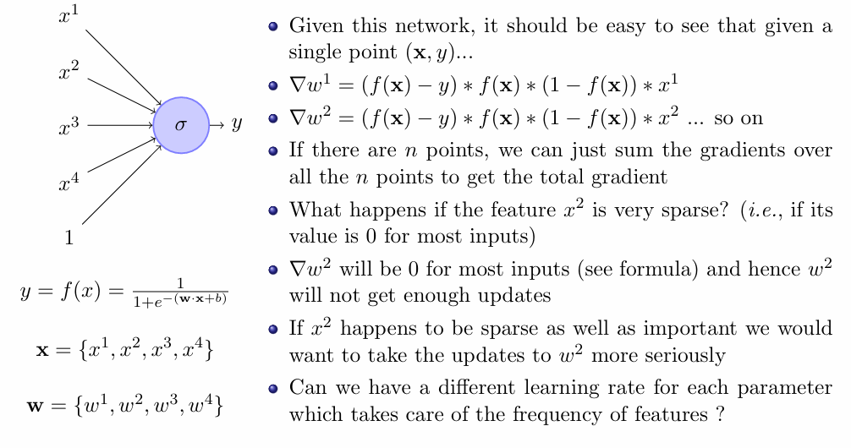
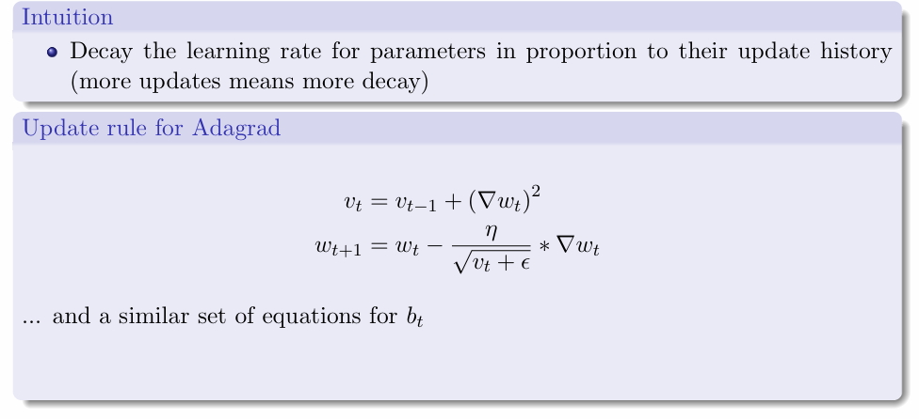
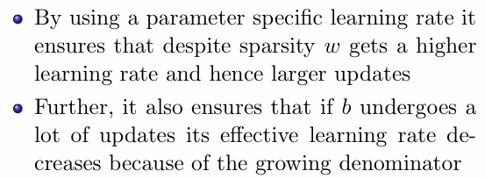
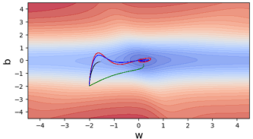
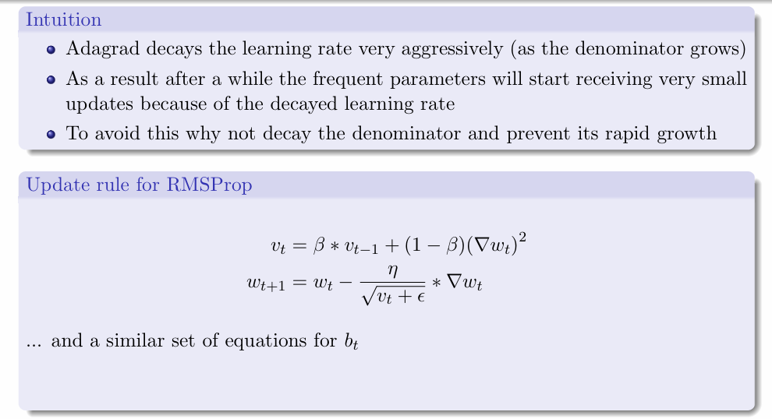
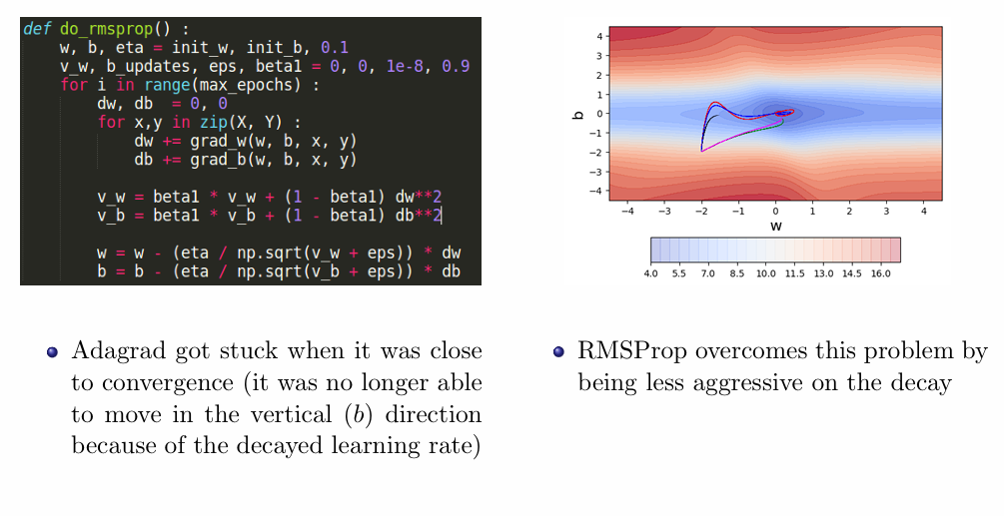
Limitations of Sparse but Important Inputs
Gradient Descent with Adaptive Learning Rate
Limitations of Adagrad
Root Mean Square Propagation

Slide 7
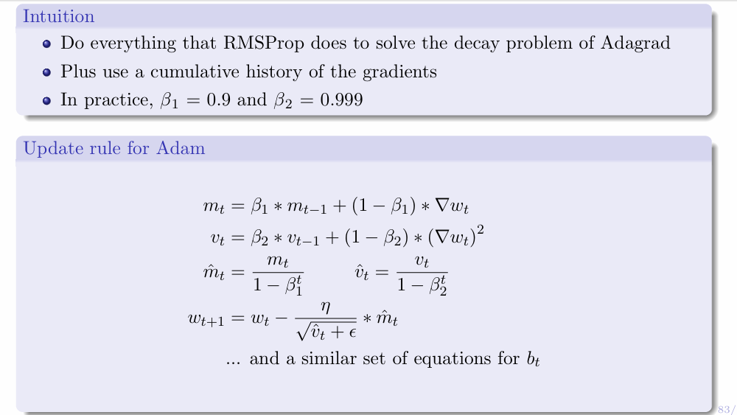
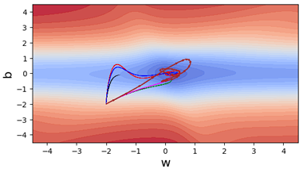
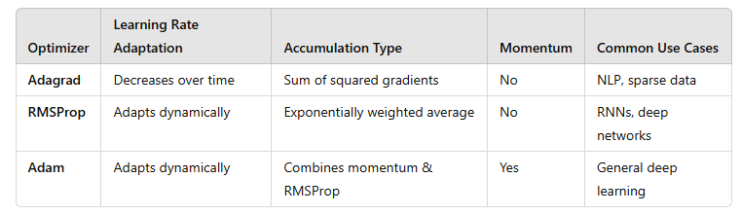
Adaptive Moment Estimation
Comparison of the Optimizers

Slide 8
Topics on which Week 4 Assignment Questions are based
Gradient Descent
Momentum based Gradient Descent
Nesterov Accelerated Gradient Descent
Stochastic and Mini-Batch Gradient Descent
Adative Gradient, Root Mean Square Propagation and Adaptive Moment Estimation

Slide 9
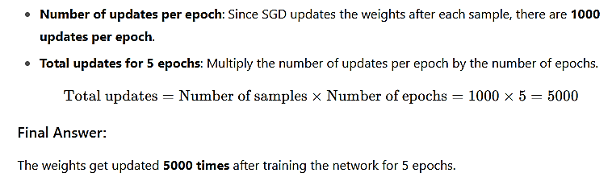
QUESTION 1
A team has a data set that contains 1000 samples for training a feed-forward neural network. Suppose they decided to use stochastic gradient descent algorithm to update the weights. How many times do the weights get updated after training the network for 5 epochs?
1000
5000
100
5
SOLUTION 1
CORRECT ANSWER 1
b)

Slide 10
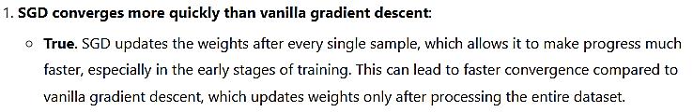
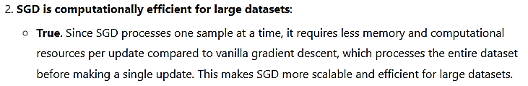
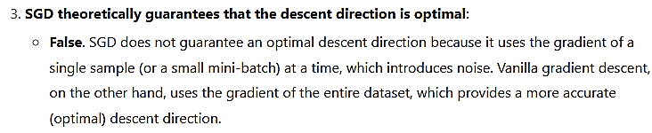
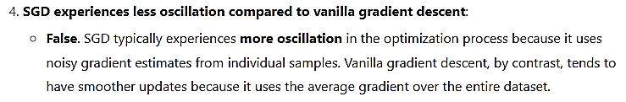
QUESTION 2
What are the benefits of using stochastic gradient descent compared to vanilla gradient descent?
SGD converges more quickly than vanilla gradient descent.
SGD is computationally efficient for large datasets.
SGD theoretically guarantees that the descent direction is optimal.
SGD experiences less oscillation compared to vanilla gradient descent.
SOLUTION 2
CORRECT ANSWER 2
a), b)

Slide 11
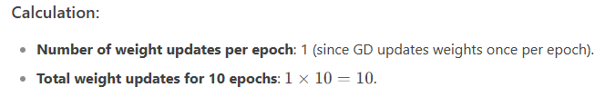
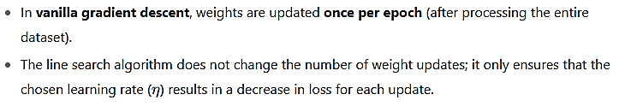

QUESTION 3
A team has a data set that contains 100 samples for training a feed-forward neural network. Suppose they decided to use the gradient descent algorithm to update the weights. Suppose further that they use line search algorithm for the learning rate as follows, η=[0.01,0.1,1,2,10]. How many times do the weights get updated after training the network for 10 epochs? (Note, for each weight update the loss has to decrease)
100
5
500
10
50
SOLUTION 3
CORRECT ANSWER 3
d)

Slide 12
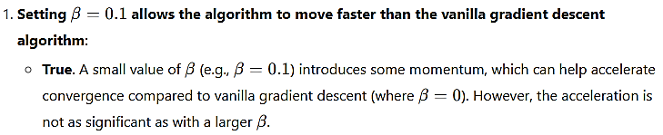

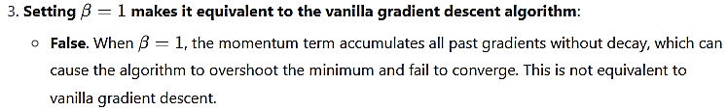
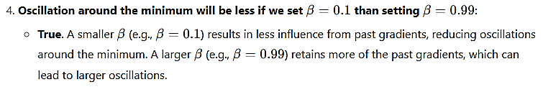
QUESTION 4
Select the true statements about the factor β used in the momentum based gradient descent algorithm.
Setting β=0.1 allows the algorithm to move faster than the vanilla gradient descent algorithm
Setting β=0 makes it equivalent to the vanilla gradient descent algorithm
Setting β=1 makes it equivalent to the vanilla gradient descent algorithm
Oscillation around the minimum will be less if we set β=0.1 than setting β=0.99
SOLUTION 4
CORRECT ANSWER 4
a), b), d)

Slide 13
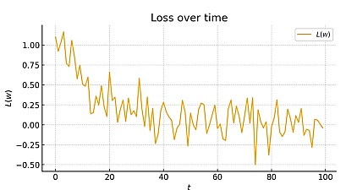
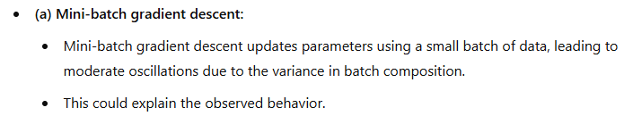
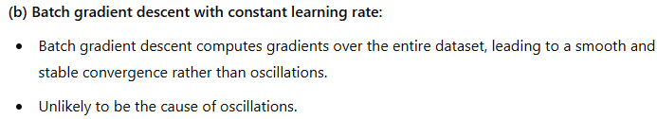
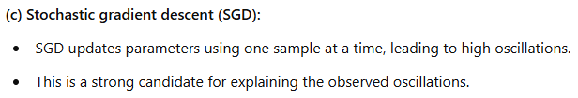
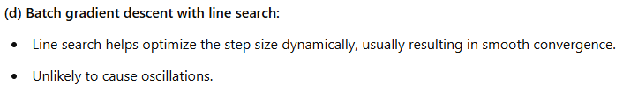
QUESTION 5
The figure below shows the change in loss value over iterations
The oscillation in the loss value might be due to
Mini-batch gradient descent algorithm used for parameter updates
Batch gradient descent with constant learning rate algorithm used for parameter updates
Stochastic gradient descent algorithm used for parameter updates
Batch gradient descent with line search algorithm used for parameter updates
SOLUTION 5
CORRECT ANSWER 5
a), c)

Slide 14
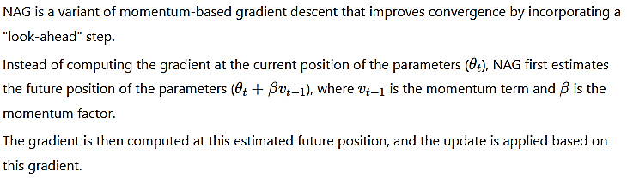
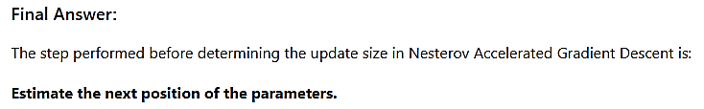
QUESTION 6
In Nesterov accelerated gradient descent, what step is performed before determining the update size?
Increase the momentum
Adjust the learning rate
Decrease the step size
Estimate the next position of the parameters
SOLUTION 6
CORRECT ANSWER 6
d)

Slide 15
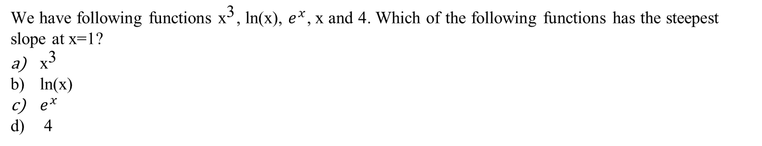
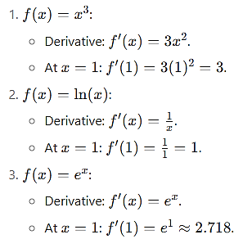
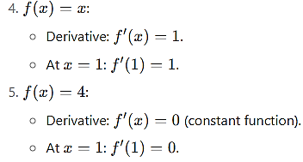
QUESTION 7
SOLUTION 7
CORRECT ANSWER 7
a)

Slide 16
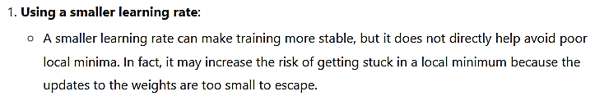
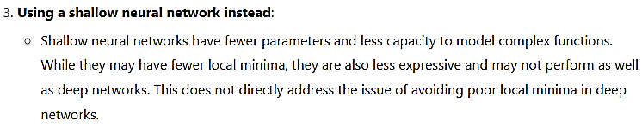

QUESTION 8
Which of the following can help avoid getting stuck in a poor local minimum while training a deep neural network?
Using a smaller learning rate.
Using a smaller batch size.
Using a shallow neural network instead.
None of the above.
SOLUTION 8
CORRECT ANSWER 8
b)

Slide 17


QUESTION 9
What are the two main components of the ADAM optimizer?
Momentum and learning rate.
Gradient magnitude and previous gradient.
Exponential weighted moving average and gradient variance.
Learning rate and a regularization term.
SOLUTION 9
CORRECT ANSWER 9
c)

Slide 18


QUESTION 10
Which of the following correctly describes the key difference between Adagrad, RMSProp, and Adam optimizers?
Adagrad and RMSProp both use momentum, but Adam does not.
RMSProp and Adam use the same update rule, but Adagrad differs by using a constant learning rate.
Adagrad accumulates squared gradients over time, RMSProp applies exponential decay to past gradients, and Adam combines momentum with adaptive learning rates.
Adam is a variant of Adagrad that removes the issue of learning rate decay using a constant update rule.
SOLUTION 10
CORRECT ANSWER 10
c)

